Slide 1
Pre-registration: What, How, and Why
Peter C.H. Lam
PhD3 | SCSD
Apr 17th, 2026
Lab Meeting

Slide 2
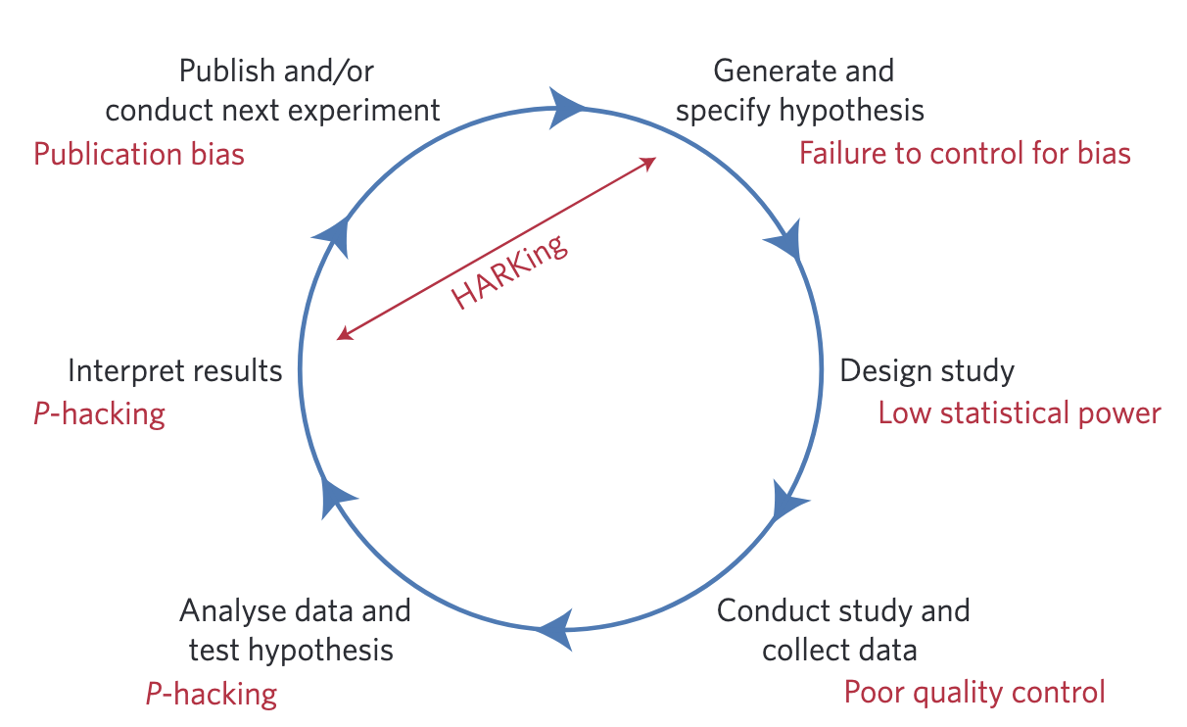
Reproducible science and threats
Hypothetico-deductive model
Munafò et al. (2017). A manifesto for reproducible science. Nature Human Behaviour.
Notes:
Threats to reproducible science. An idealized version of the hypothetico-deductive model of the scientific method is shown. Various potential threats to this model exist (indicated in red), including lack of replication, hypothesizing after the results are known (HARKing), poor study design, low statistical power, analytical flexibility, P-hacking, publication bias and lack of data sharing. Together these will serve to undermine the robustness of published research, and may also impact on the ability of science to self-correct.

Slide 3
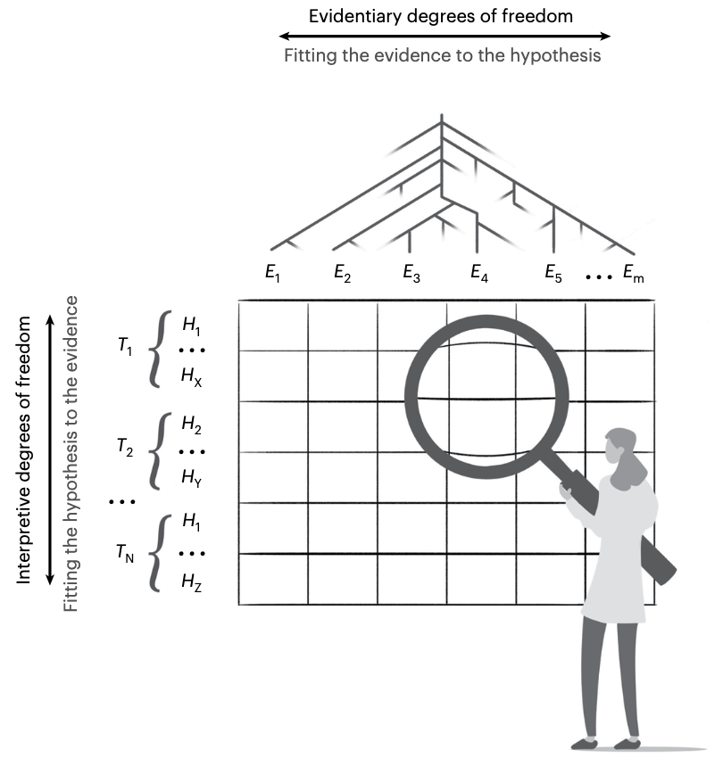
Motivations for OS: A recap
Researchers possess a generous amount of freedom in the design, analysis, and interpretation of scientific studies
The current incentive structure typically rewards surprising, positive, coherent results
Fertile ground for self- and other-fooling
Open science (OS) practices could reduce bias and increase transparency
Hardwicke & Wagenmakers. (2023). Reducing bias, increasing transparency and calibrating confidence with preregistration. Nature Human Behaviour.

Slide 4
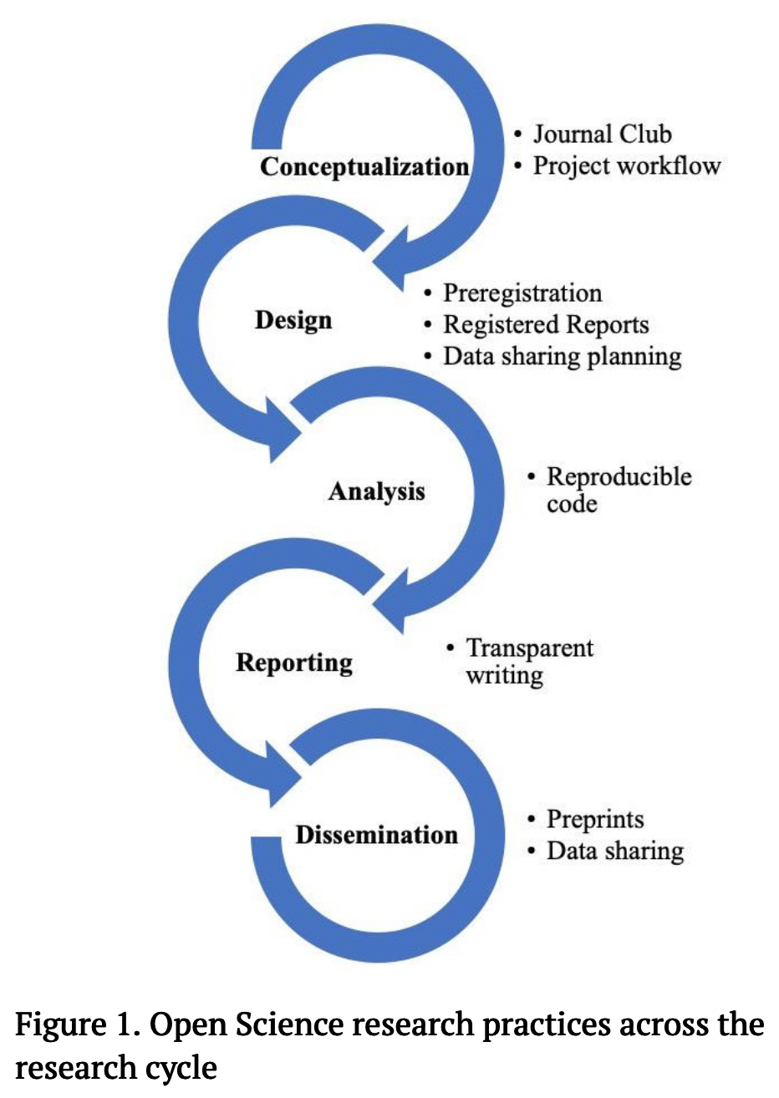
Open science is many things
At varying degrees of difficulty
Easy
Medium
(exc. hard for RRs)
Medium
Medium
Kathawalla, U.-K., Silverstein, P., & Syed, M. (2021). Easing Into Open Science: A Guide for Graduate Students and Their Advisors. Collabra: Psychology.
Easy
Medium

Slide 5
Preregistration
Time-stamped, read-only document of detailed predictions and experiment/analysis protocols, before data collection begins
https://help.osf.io/article/330-welcome-to-registrations

Slide 6
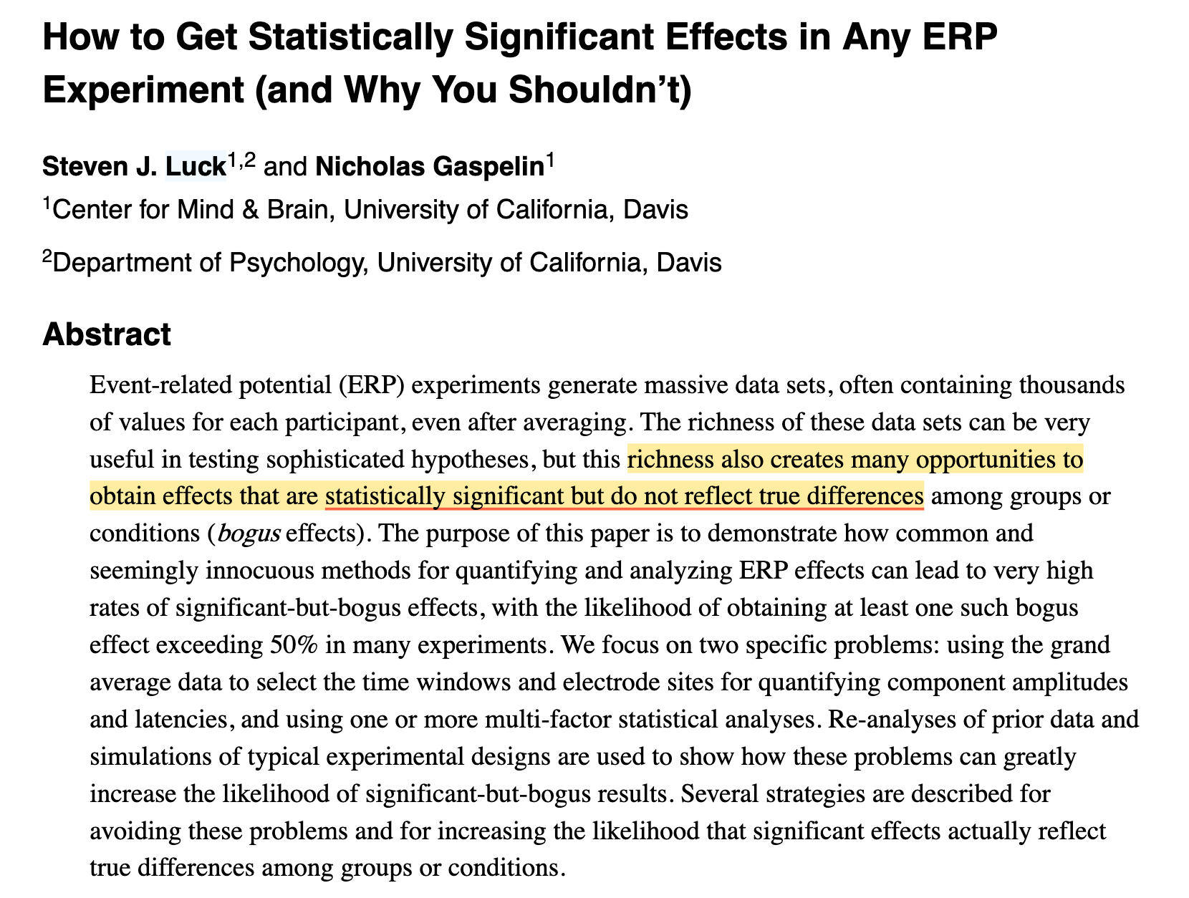
Why?
The problem with degrees of freedom
Sample size
Number of trials
Reference electrode
Baseline period selection
Mean amplitude time windows
Electrode choice and ROI assignments
…

Slide 7
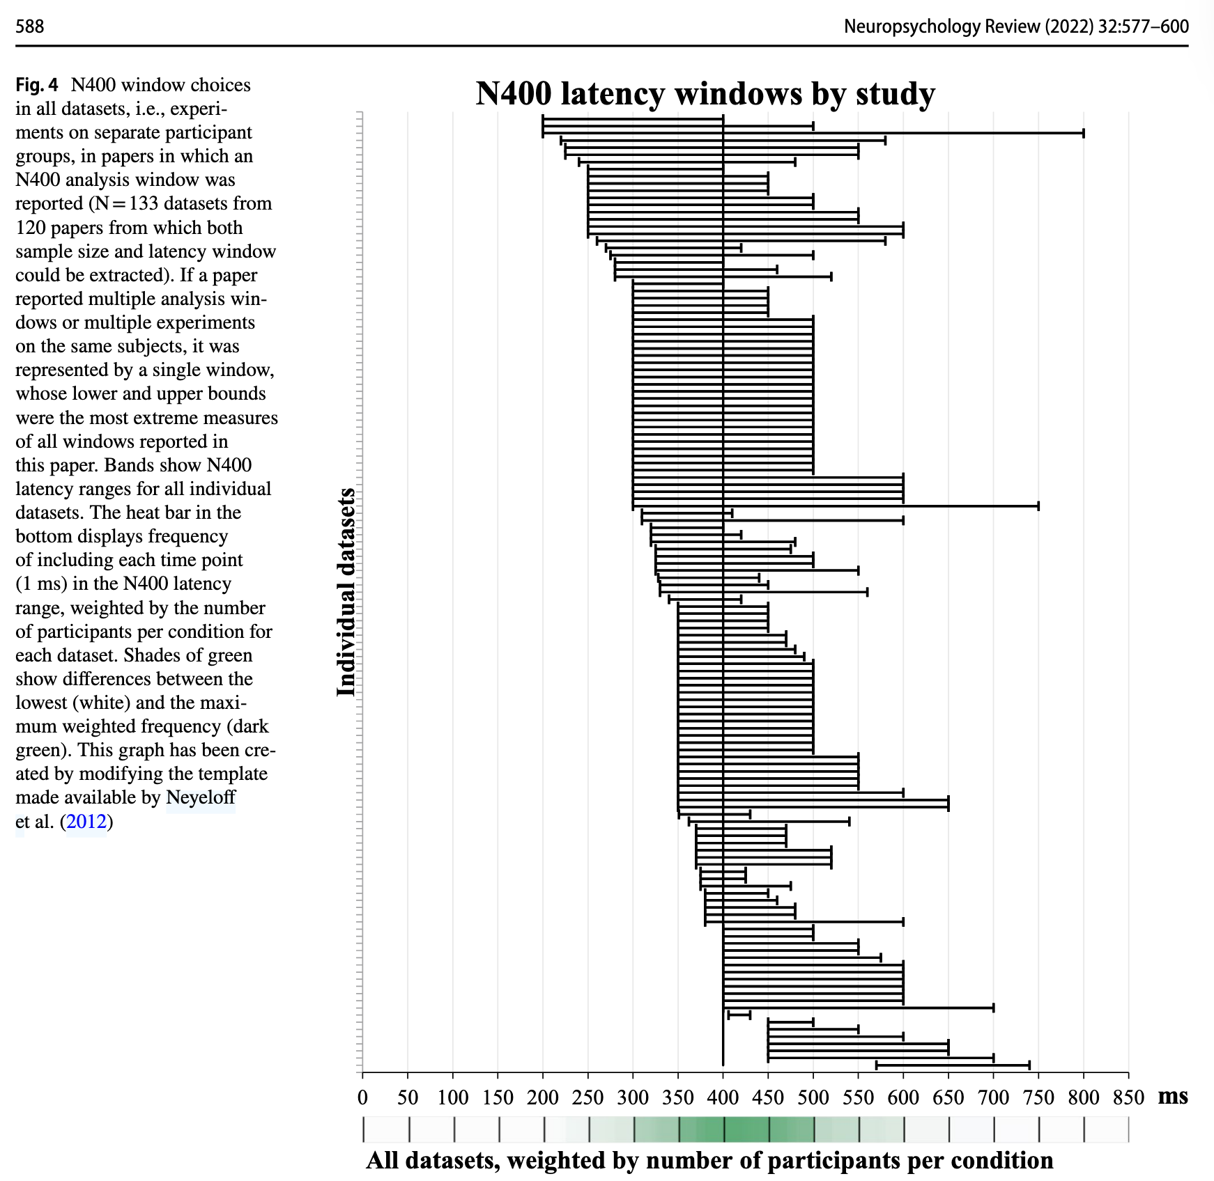
Why?
The problem with degrees of freedom
Sample size
Number of trials
Reference electrode
Baseline period selection
Mean amplitude time windows
Electrode choice and ROI assignments
…

Slide 8
Why?
For science
Transparency and verifiability
Stick to a priori decisions/principles
Differentiate confirmatory and exploratory analyses: Prevent HARKING/p-hacking
For the scientist
Increase publication odds and the lab’s credibility
Frontloading the work: prevents mistakes and surprises after collection
E.g., the data collected doesn’t allow for intended analysis

Slide 9
How to preregister your (EEG) study?

Slide 10
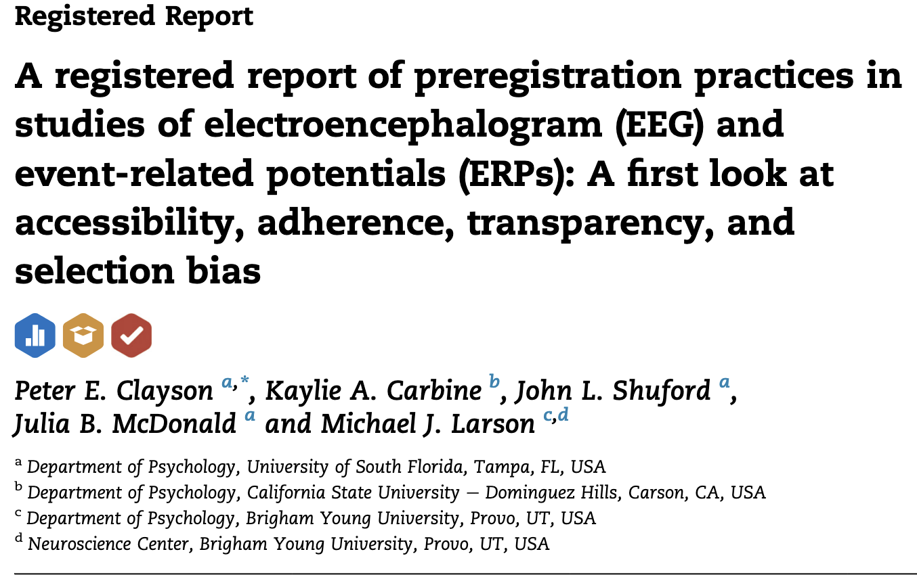
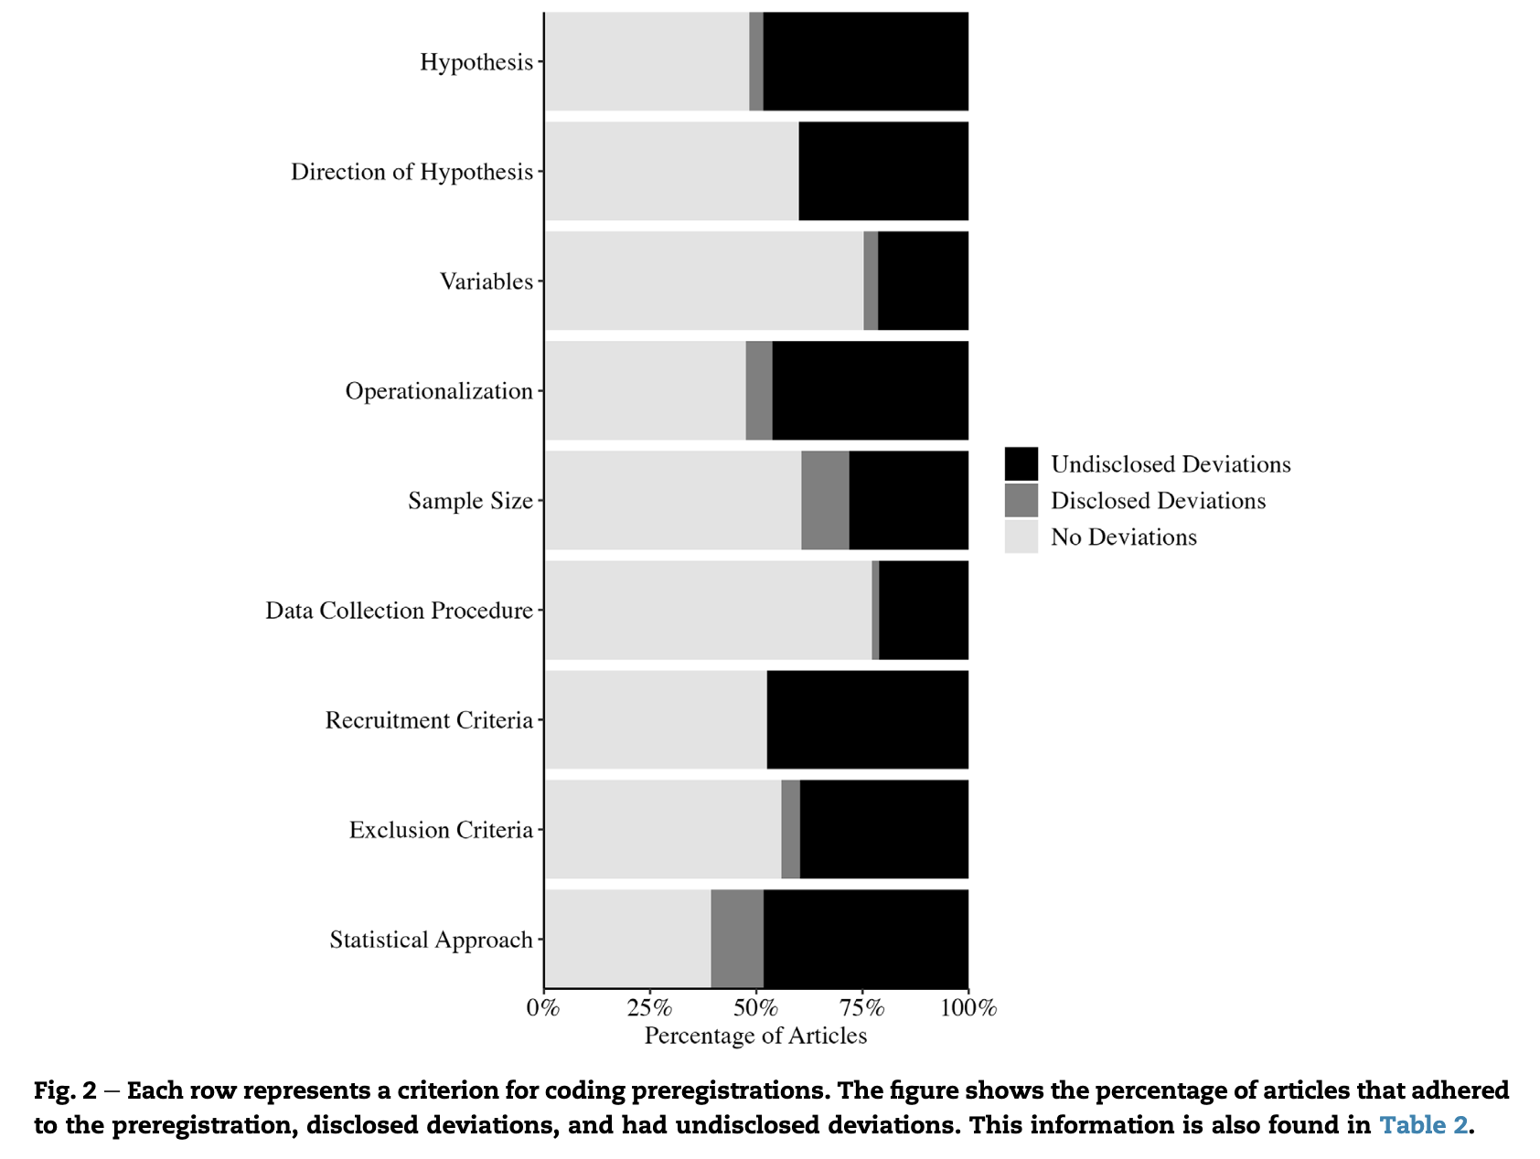
Good and bad preregistrations
Notes:
Even good preregistrations don’t prevent you from doing bad science!

Slide 11
How to preregister your (EEG) study?
The template for your plan
Govaart et al. (2022). EEG and ERP Methods—Preregistration Template. MetaArXiv. https://doi.org/10.31222/osf.io/4nvpt
The template to transparently deviate from your plan
https://osf.io/x5w7h/files/yrvcg

Slide 12
Thank you for your attention!

Slide 13
References
Clayson, P. E., Keil, A., & Larson, M. J. (2022). Open science in human electrophysiology. International Journal of Psychophysiology, 174, 43–46. https://doi.org/10.1016/j.ijpsycho.2022.02.002
Govaart, G. H., Schettino, A., Helbling, S., Mehler, D. M. A., Ngiam, W. X. Q., Moreau, D., Chiossi, F., Zanesco, A. P., Yang, Y.-F., Gau, R., Bartlett, J. E., García Alanis, J. C., Gutsell, J. N., Çetinçelik, M., Pavlov, Y. G., Šoškić, A., Ehinger, B. V., Mouseli, P., Algermissen, J., … Paul, E. (2022). EEG and ERP Methods—Preregistration Template. MetaArXiv. https://doi.org/10.31222/osf.io/4nvpt
Kathawalla, U.-K., Silverstein, P., & Syed, M. (2021). Easing Into Open Science: A Guide for Graduate Students and Their Advisors. Collabra: Psychology, 7(1), 18684. https://doi.org/10.1525/collabra.18684
Keil, A., Bernat, E. M., Cohen, M. X., Ding, M., Fabiani, M., Gratton, G., Kappenman, E. S., Maris, E., Mathewson, K. E., Ward, R. T., & Weisz, N. (2022). Recommendations and publication guidelines for studies using frequency domain and time-frequency domain analyses of neural time series. Psychophysiology, 59(5), e14052. https://doi.org/10.1111/psyp.14052
Meyer, M. N. (2018). Practical Tips for Ethical Data Sharing. Advances in Methods and Practices in Psychological Science, 1(1), 131–144. https://doi.org/10.1177/2515245917747656
Paul, M., Govaart, G. H., & Schettino, A. (2021). Making ERP research more transparent: Guidelines for preregistration. International Journal of Psychophysiology, 164, 52–63. https://doi.org/10.1016/j.ijpsycho.2021.02.016
Schapira, M., & Harding, R. J. (2019). Open laboratory notebooks: Good for science, good for society, good for scientists. F1000Research, 8, 87. https://doi.org/10.12688/f1000research.17710.2
Šoškić, A., Jovanović, V., Styles, S. J., Kappenman, E. S., & Ković, V. (2022). How to do Better N400 Studies: Reproducibility, Consistency and Adherence to Research Standards in the Existing Literature. Neuropsychology Review, 32(3), 577–600. https://doi.org/10.1007/s11065-021-09513-4

